Slide 1
MISSIONAL
CHARACTERISTICS
of children

Slide 2
MISSIONAL
CHARACTERISTICS
LEARN ABOUT MISSIONS
PRAY FOR MISSIONS
SUPPORT MISSIONS
DO MISSIONS AND TELL ABOUT JESUS

Slide 3
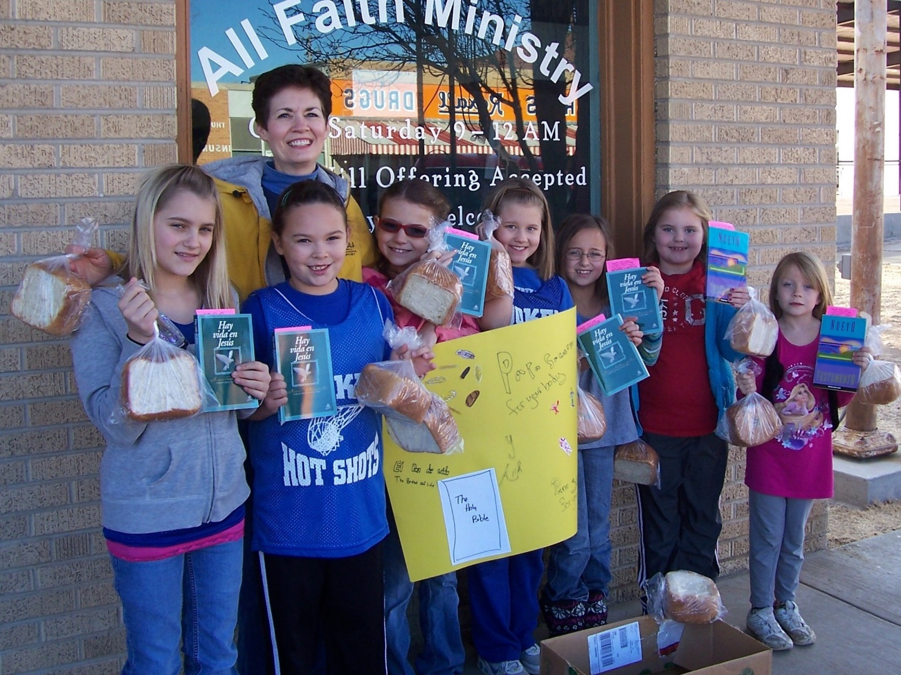
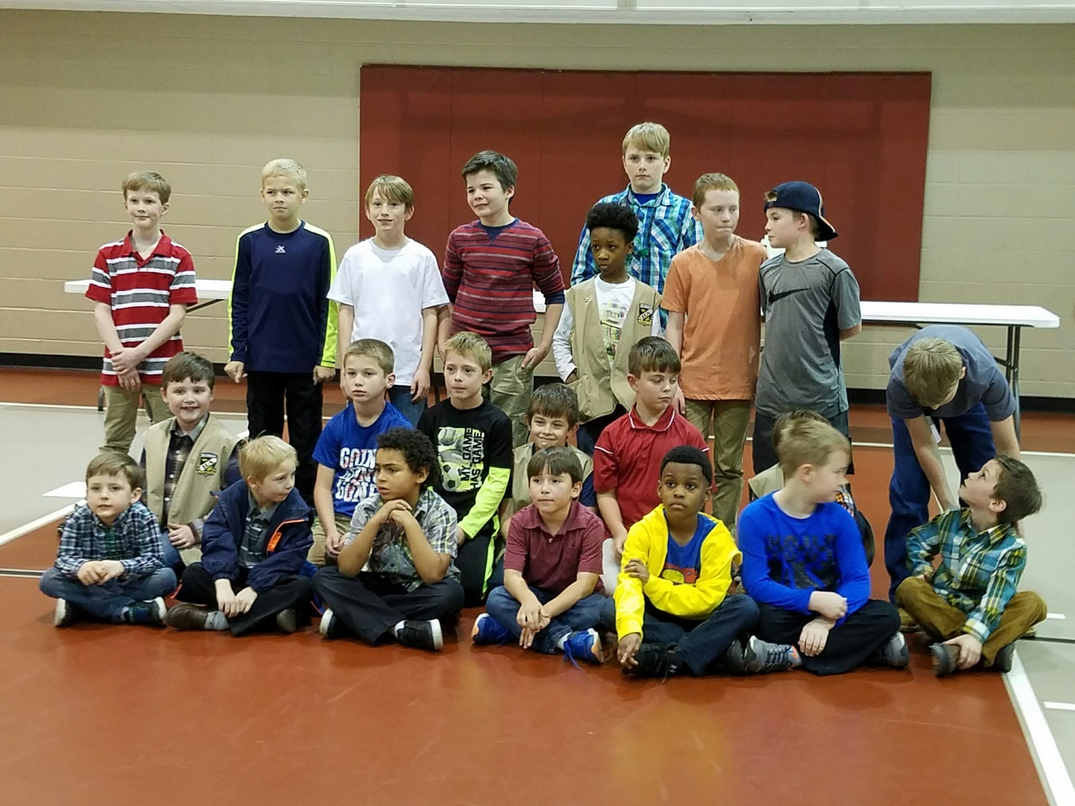
MISSIONAL
CHARACTERISTICS
LEARN ABOUT MISSIONS

Slide 4
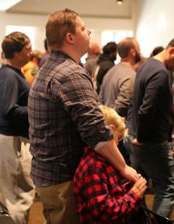
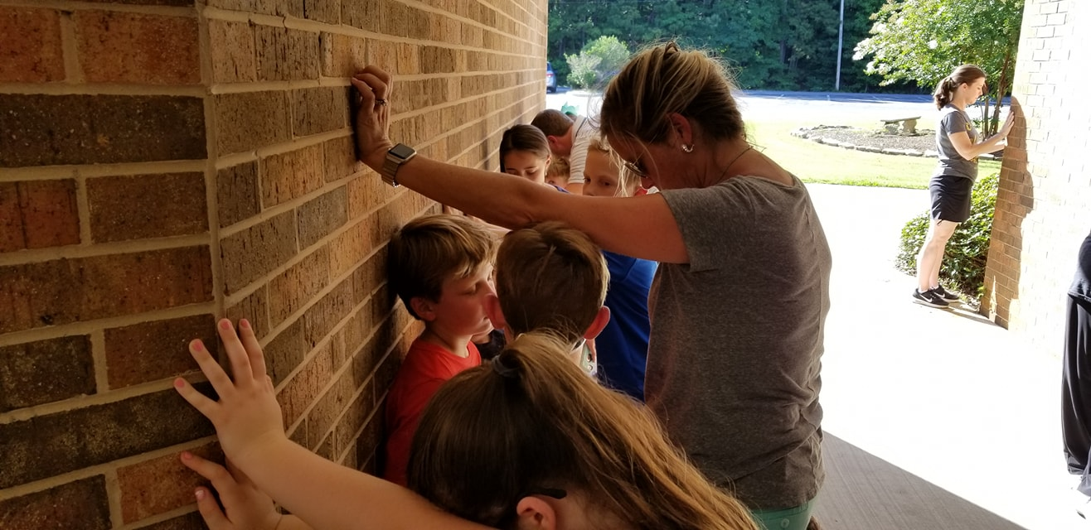
MISSIONAL
CHARACTERISTICS
PRAY FOR MISSIONS

Slide 5
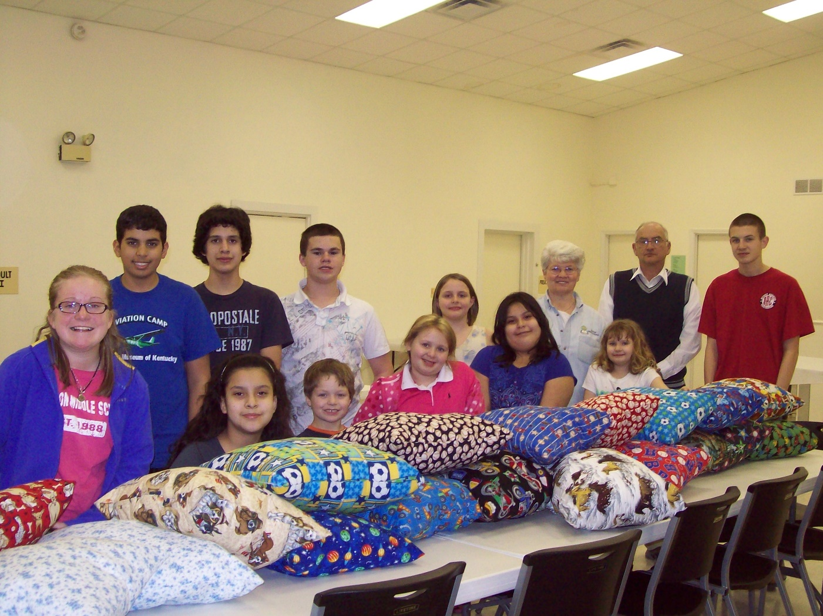
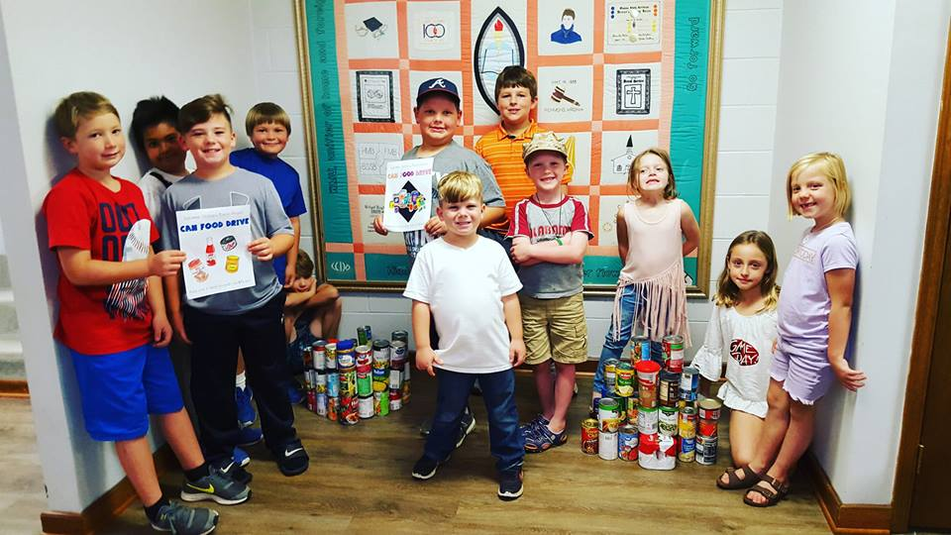
MISSIONAL
CHARACTERISTICS
SUPPORT MISSIONS

Slide 6
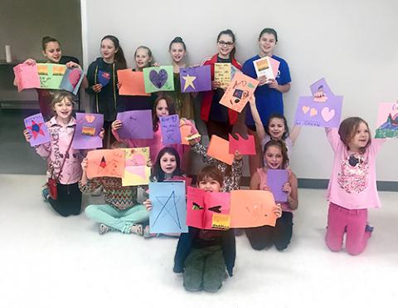
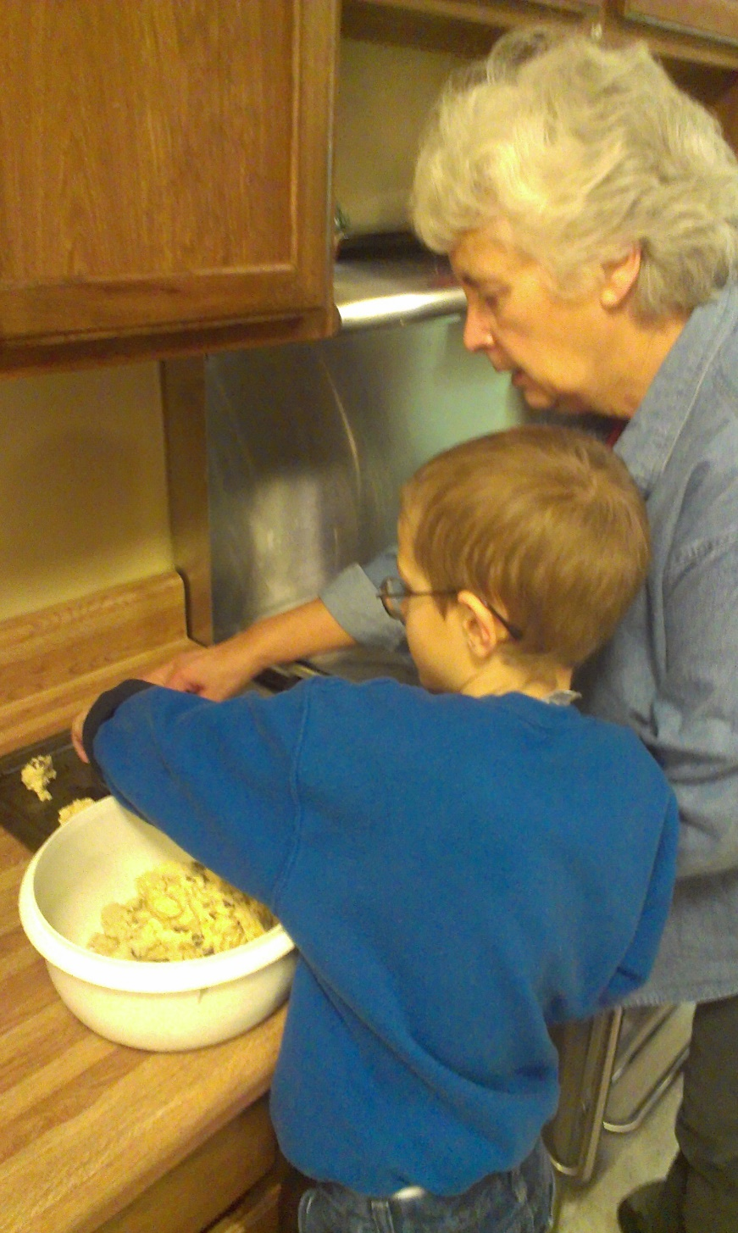
MISSIONAL
CHARACTERISTICS
DO MISSIONS AND TELL ABOUT JESUS

Slide 7
MISSIONAL
CHARACTERISTICS
LEARN ABOUT MISSIONS
PRAY FOR MISSIONS
SUPPORT MISSIONS
DO MISSIONS AND TELL ABOUT JESUS

